Slide 1








Slide 2



















Slide 3















Slide 4




















Slide 5











Slide 6








Slide 7














Slide 8











Slide 9















Slide 10










Slide 11






PERIYAR BUS STAND SHOPPING COMPLEX

Slide 12













Slide 13













BHARATHIRAJA HOSPITAL
PILLAR HOSPITAL
ANDAMAN & NICOBAR ISLANDS

Slide 14










GUDUR RESTAURANT CONVENTION
TAMUKKAM CONVENTION CENTRE MADURAI

Slide 15



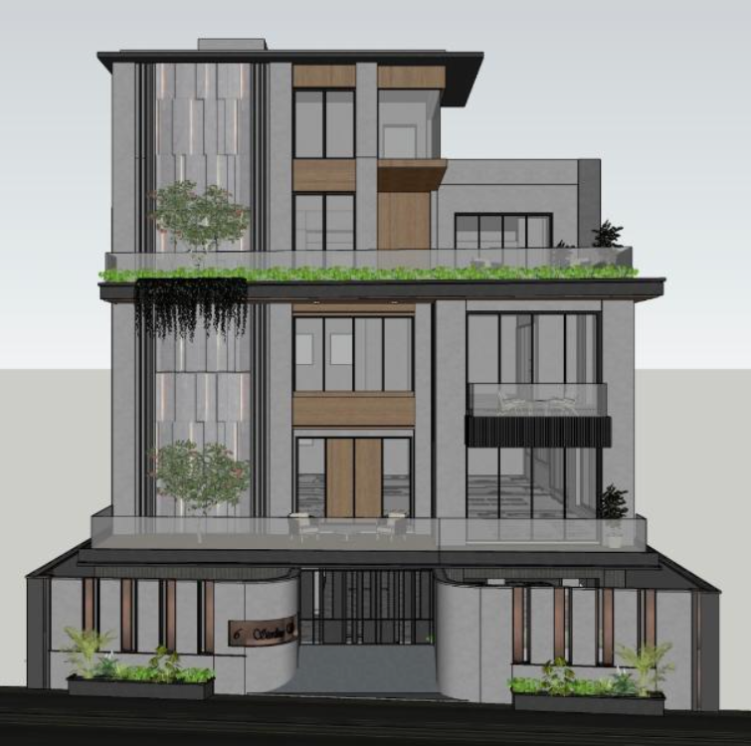



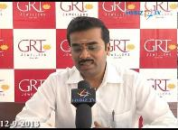

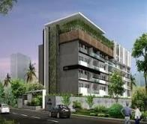


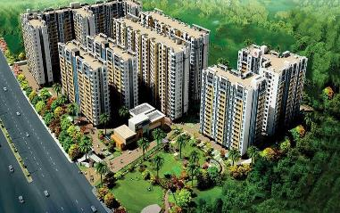
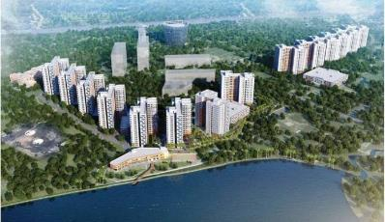
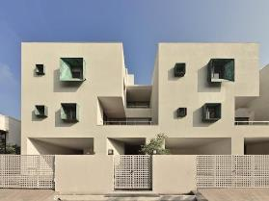
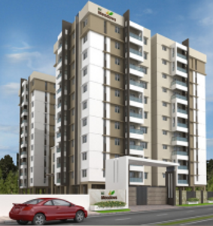


VIKRAM CHOUDHARY
Residence of
Mr. Gopal Srinivasan
Residence of
Mr. ANANTHAPADMANABHAN
ROW HOUSES AT ECR
RC - MEADOWS

Slide 16
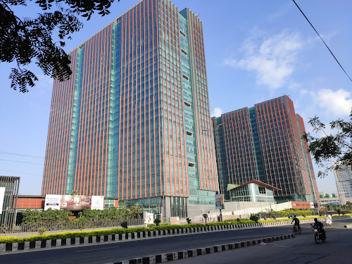
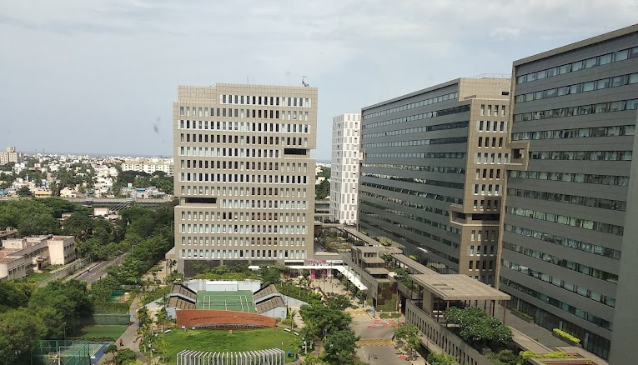
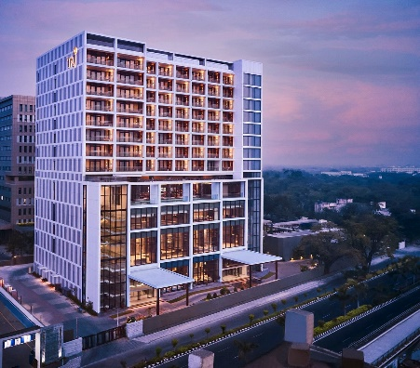
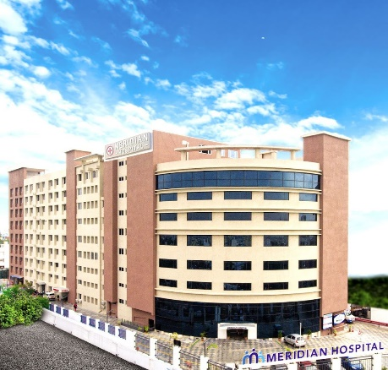
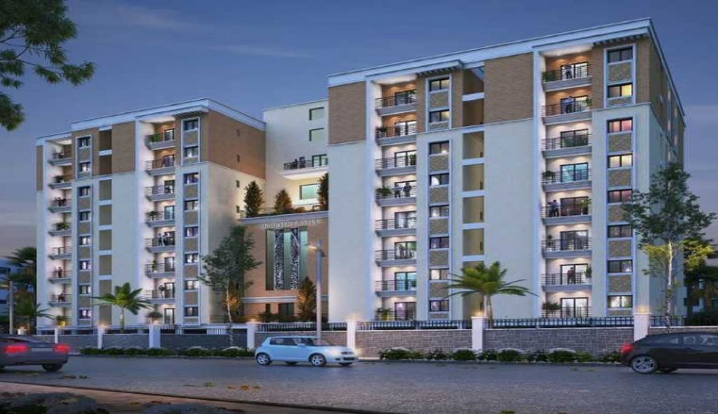
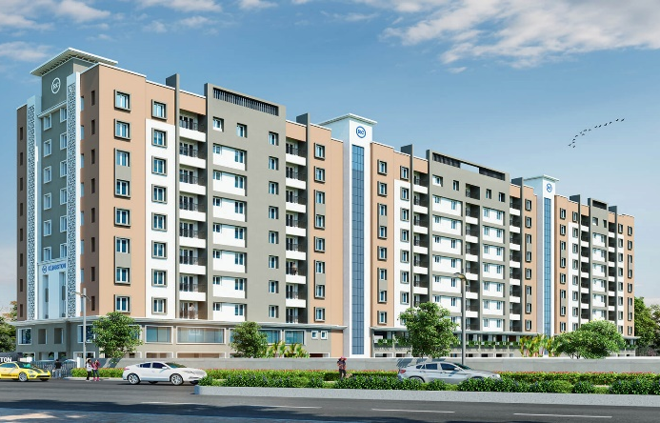
WORLD TRADE CENTER
TRILL IT PARK CHENNAI
TAJ HOTEL CHENNAI
MERIDIAN HOSPITAL
RAJARATHNAM CONSTRUCTION
JONES CASTLE
RAJARATHNAM CONSTRUCTION KINGSTON

